Slide 1

Sets and Maps

Slide 2
Set vs List vs Map
Set, List and Map are interfaces,
List in Java provides ordered and indexed collection which may contain duplicates.
Set provides an un-ordered collection of unique objects, i.e. Set doesn't allow duplicates,
Map provides a data structure based on key value pair and hashing.

Slide 3
Duplicate Objects
List allows duplicates
Set doesn't allow duplicates.
Map holds two object per Entry e.g. key and value and It may contain duplicate values but keys are always unique.

Slide 4
Order
List is an ordered collection, List's contract maintains insertion order or element.
Set and maps are an unordered collection, you get no guarantee on which order element will be stored.

Slide 5
Null elements
List allows null elements and you can have many null objects in a List because it also allowed duplicates.
Set just allow one null element as there is no duplicate permitted
Map you can have null values and at most one null key

Slide 6
Popular implementation
List interface : ArrayList, LinkedList and Vector class.
ArrayList provides random access with index,
LinkedList is more suitable for frequently adding and removing elements from List.
Vector is synchronized counterpart of ArrayList.
Set interface are HashSet, LinkedHashSet
Map interface is HashMap

Slide 7
When to use List, Set and Map in Java
If you need to access elements frequently by using index, than List is a way to go. Its implementation e.g. ArrayList provides faster access if you know index.
2) If you want to store elements and want them to maintain an order on which they are inserted into collection then go for List again, as List is an ordered collection and maintain insertion order.

Slide 8
When to use List, Set and Map in Java
If you want to create collection of unique elements and don't want any duplicate than choose any Set implementation e.g. HashSet, LinkedHashSet or TreeSet
If you store data in form of key and value than Map is the way to go. You can choose from Hashtable, HashMap, TreeMap based upon your subsequent need.

Slide 9
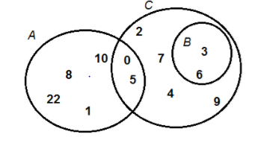
The Set interface
A Set is unordered and has no duplicates
Operations are exactly those for Collection

Slide 10
The Set interface
A Set is unordered and has no duplicates
Operations are exactly those for Collection
int size( );
boolean isEmpty( );
boolean contains(Object e);
boolean add(Object e);
boolean remove(Object e);
Iterator iterator( );
boolean containsAll(Collection c);
boolean addAll(Collection c); boolean removeAll(Collection c);
boolean retainAll(Collection c);
void clear( );
Object[ ] toArray( );
Object[ ] toArray(Object a[ ]);

Slide 11
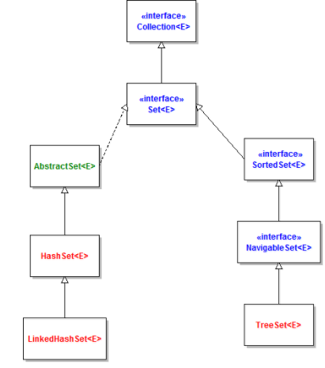
Set Implementations
three major
implementations
HashSet,
LinkedHashSet
TreeSet.

Slide 12
characteristics of each implementation
HashSet: is the best-performing implementation and is a widely-used Set implementation. It represents the core characteristics of sets: no duplication and unordered.
LinkedHashSet: This implementation orders its elements based on insertion order. So consider using a LinkedHashSet when you want to store unique elements in order.
TreeSet: This implementation orders its elements based on their values, either by their natural ordering, or by a Comparator provided at creation time.

Slide 13
Creating a new Set
Set of integer numbers:
LinkedHashSet
Add elements
Numbers.add(10);
Numbers.add(34);
Numbers.add(5);
Numbers.add(2);

Slide 14


Set from an existing collection

Slide 15



Removing an element from a Set:
If you want to remove all elements

Slide 16
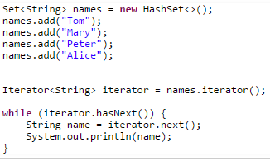
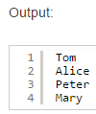

Iterating over elements in a Set

Slide 17

Performing Bulk Operations between two Sets
subset, union, intersection and set difference
Subset operation:
s1.containsAll(s2) returns true if s2 is a subset of s1

Slide 18
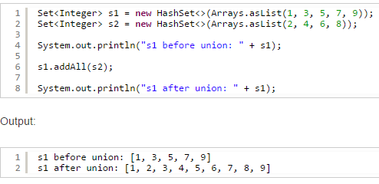
Union operation:
s1.addAll(s2) — transforms s1 into the union of s1 and s2.

Slide 19
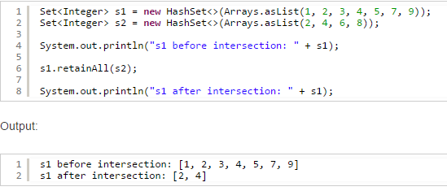
Intersection operation
s1.retainAll(s2) — transforms s1 into the intersection of s1 and s2
(The intersection of two sets is the set containing only the elements common to both sets.)

Slide 20
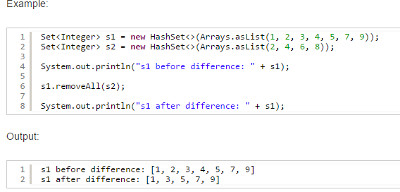
Set difference operation:
s1.removeAll(s2) — transforms s1 into the (asymmetric) set difference of s1 and s2. (
For example, the set difference of s1 minus s2 is the set containing all of the elements found in s1 but not in s2.)

Slide 21
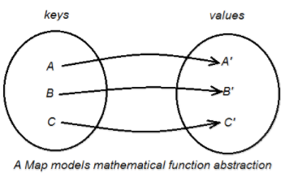
Overview of Map Collection
A Map is an object that maps keys to values, or is a collection of attribute-value pairs
A Map cannot contain duplicate keys and each key can map to at most one value.

Slide 22
When Use Maps:
Use Maps when you want to retrieve and update elements by keys, or perform lookups by keys. Some examples:
A map of error codes and their descriptions.
A map of zip codes and cities.
A map of managers and employees. Each manager (key) is associated with a list of employees (value) he manages.
A map of classes and students. Each class (key) is associated with a list of students (value).

Slide 23
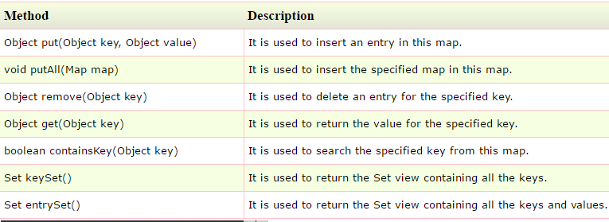

Methods for Map

Slide 24
Implementations of Map
HashMap :
uses a hash table
does not guarantee the order of its key-value elements.
LinkedHashMap
uses a hash table and a linked list
insertion-order as the default order.
key-value pairs are sorted by their insertion order
TreeMap
Uses red-black tree
Elements are sorted according to the natural ordering of its keys

Slide 25
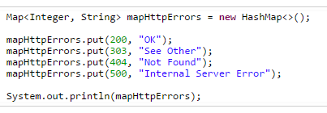
Creating a new HashMap
You can create a new Map that copies elements from an existing map.

Slide 26
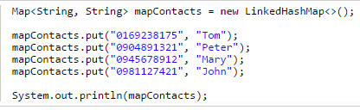
Creating a LinkedHashMap:

Slide 27
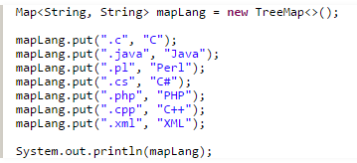
Creating a TreeMap:

Slide 28


Performing Basic Operations on a Map
association (put), lookup (get), checking (containsKey and containsValue), modification (remove and replace) and cardinality (size and isEmpty).
Getting a value associated with a specified key:

Slide 29

Checking if the map contains a specified key:

Slide 30

Checking if the map contains a specified value:

Slide 31

Removing a mapping from the map

Slide 32

Replacing a value associated with a specified key:

